Slide 1



KEC HACKATHON 2025
Problem Statement ID – PSA2
Title – Rural Artisan E-commerce Platform
Domain – Social Good and Accessibility
Team Name - Team Fortune
Team Lead Name – Sowbharanika Janani J S
College - Kongu Engineering College
TEAM MEMBERS
Sowbharanika Janani J S (22ADL132)
Kamalica R(22ALR036)
Hairunisha A(22ALR024)
Tharun R(23ADR175)
MENTOR
Dr.K.Sathya
Associate Professor
Kongu Engineering College

Slide 2
Team Fortune
Rural Artisan E-commerce Platform
Proposed Solution
Direct Marketplace: A user-friendly website and mobile app where rural artisans can list and sell their products directly to consumers worldwide.
Fair Pricing: Tools to help artisans set equitable prices, with transparent pricing to ensure they earn a fair share.
Artisan Profiles: Personalized profiles for artisans to share their stories, enhancing the cultural value of their crafts.
Marketing Support: Integrated social media tools and promotional campaigns to increase visibility.
Secure Transactions: Payment systems integrated to guarantee safe transactions for both buyers and sellers.
@kechackathon2025
2

Slide 3
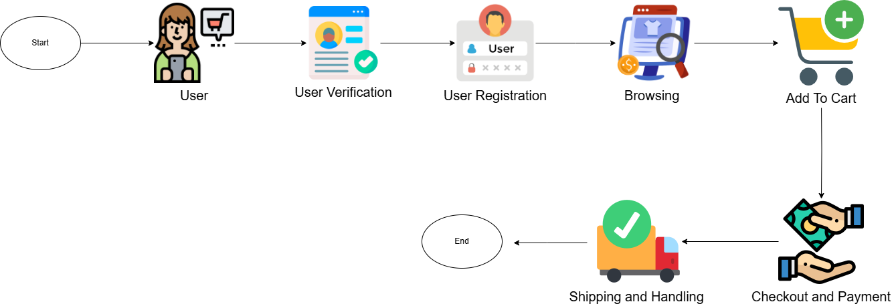
Team Fortune
TECHNICAL APPROACH
@kechackathon2025
3

Slide 4
Team Fortune
FEASIBILITY AND VIABILITY
Feasibility
Technical Feasibility:
1.Uses technologies like MongoDB, Express.js, React.js, Node.js
2.Scalable architecture with secure payment gateways.
Financial Feasibility:
1.Revenue streams: Commissions, sponsored listings.
2.Outbreak possible within 1-2 years.
Operational Feasibility:
1.Logistics handled via third-party courier partnerships
Viability
Market Demand:
1.Growing preference for handmade, ethical products
Competitive Advantage:
1.AI-powered pricing
2.Differentiation via user-friendly & engaging platform
@kechackathon2025
4

Slide 5
Team Fortune
IMPACT AND BENEFITS
Impact:
Economic Empowerment – Increases income and financial stability for rural artisans by connecting them to global markets.
Cultural Preservation – Helps artisans showcase their heritage, preserving traditional craftsmanship for future generations.
Community Development – Revenue reinvestment supports local education, healthcare, and infrastructure, improving overall living standards.
Consumer Awareness & Trust – Educates customers on ethical buying, making them more engaged and responsible consumers.
Benefits:
Fair Trade & Ethical Pricing – Ensures artisans receive fair compensation, leading to better livelihoods.
Branding & Visibility – Allows artisans to build personal brands, increasing demand for their work.
Sustainability & Eco-Friendliness – Encourages responsible production and consumption, supporting environmentally friendly practices.
@kechackathon2025
5

Slide 6
Team Fortune
RESEARCH AND REFERENCE
International Journal of Management, Technology, and Social Sciences (IJMTS), ISSN:2581-6012,Vol.8,No.1,February2023-https://doi.org/10.1145/3427423.3427463
Journal of Informatics Education and Research ISSN: 1526-4726 Vol 4 Issue 2 (2024)
International Journal of Research Publication and Reviews Journal homepage: www.ijrpr.com ISSN 2582-7421
Hermawan, H. D., Noor, Z. M., Pramudita, D. A., & Ismoyo, D. P. (2020, November). Acceptance of e-commerce at rural level: villagers' perspective. In Proceedings of the 5th International Conference on Sustainable Information Engineering and Technology (pp. 250-255). -https://doi.org/10.1145/3427423.3427463
International Journal of Management, Technology, and Social Sciences (IJMTS), ISSN: 2581-6012, Vol. 8, No. 1, February 2023
@kechackathon2025
6

